Slide 1
Data Modeling @ CMS
Theresa Lissauer
Data Architect, Centers for Medicare & Medicaid Services

Slide 2
Topics
Historical / Cultural Perspective
Current Approach
Our Perspective on Eligibility

Slide 3
Data Description Practices
Focal Topics & Scale
Data Exchange
Enterprise
Beneficiary
(local models)
Provider
(local models)
Claim
(local models)
Traditionally Strong Payment-focused Culture
Shifting Focus to Performance and Outcomes
X12 !
HL7 ?

Slide 4
CMS’ Data Modeling Lineage
1990’s
Logical Enterprise Data Model
Entity Relationship Model (ERwin)
Early
2000’s
High-level Information Model
UML Class Diagram (Rational Rose)
Today
Conceptual Data Model
Harmonizing Historic and Project-level Models
Integrated Application Models
Influenced by early HL7 and Universal Modeling Concepts
Object Role Model (Visio . . . Troux?)
Leveraging BPM Efforts to Harvest Information Exchange Packages

Slide 5
Current [features] Approach
Content
“High-level domain-focused concepts important to the enterprise” [Source: HHS EA]
“Simply formulated statements that describe the essential nature of the enterprise” [Source: HHS EA]
Method [Leverage IEP Description]
CMS Process Modeling Engagements
HHS Collaboration / NIEM Collaboration

Slide 6
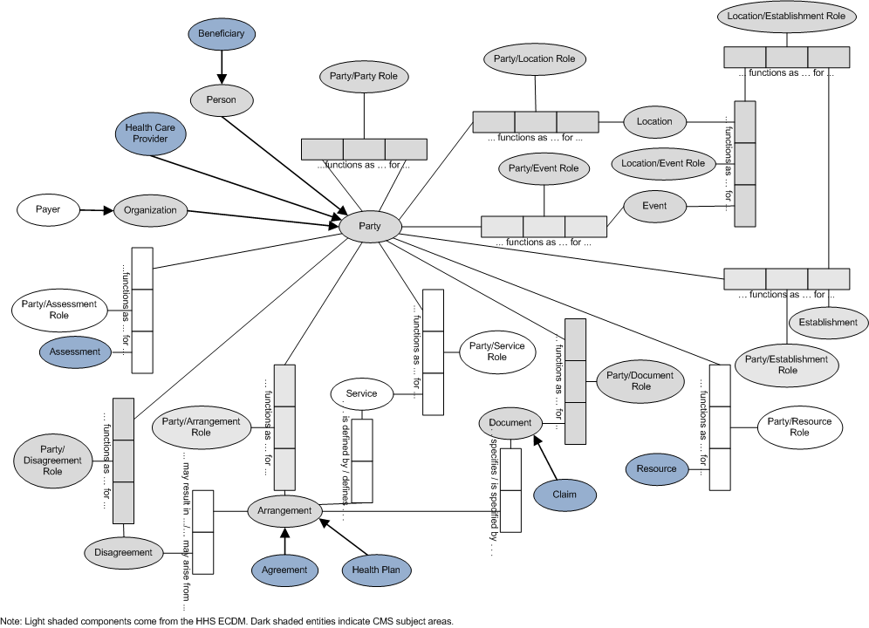
CMS ECDM: Meta-level

Slide 7
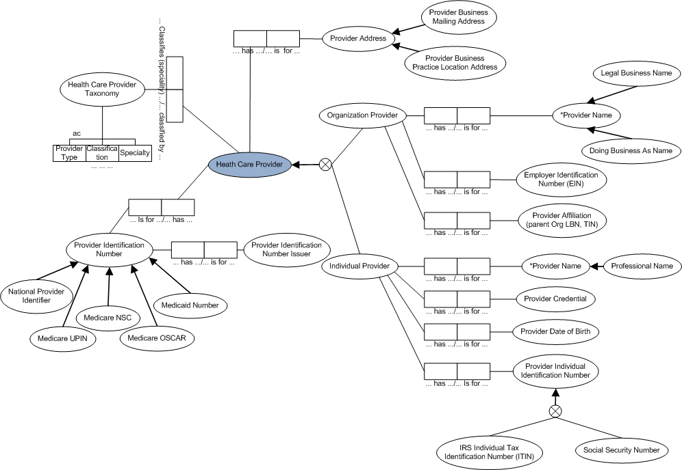
ECDM: Provider Identity Partition

Slide 8
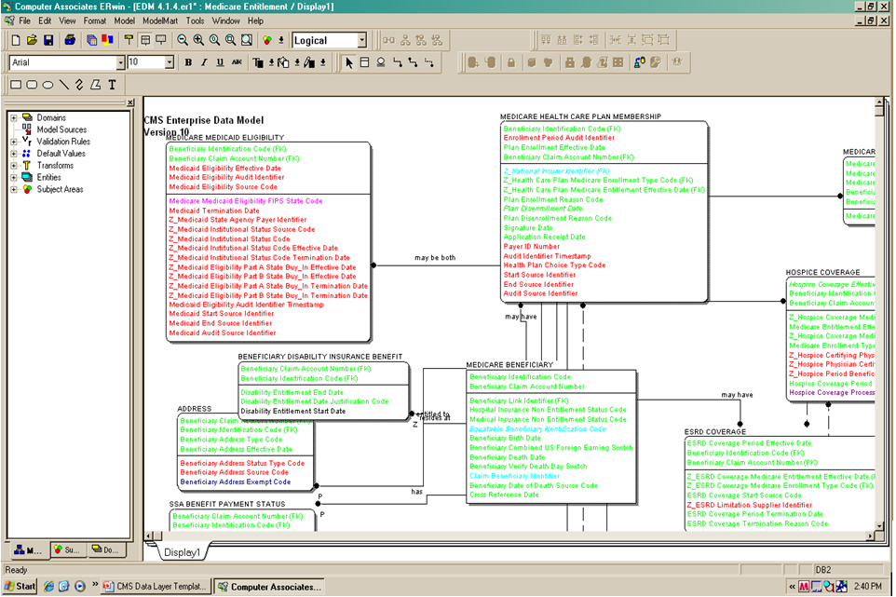
EDM: Beneficiary Subject Area

Slide 9
CMS’ Perspective on Eligibility
E³
Basis for Our Understanding – SSA Act, Title 18
Sec. 226. [42 U.S.C. 426] (a) Every individual who—
(1) has attained age 65, and . . .
. . . is entitled to monthly insurance benefits
Sec. 1836. [42 U.S.C. 1395o] Every individual who—
(1) is entitled to hospital insurance benefits under part A, or . . .
. . . is eligible to enroll in the insurance program established by this part.

Slide 10
CMS’ Perspective on Eligibility
Context is Important within CMS
By Line of Business
Medicare “entitlement” vs. Medicaid “eligibility”
Within LOB
Eligibility for Specific Services

